Slide 1
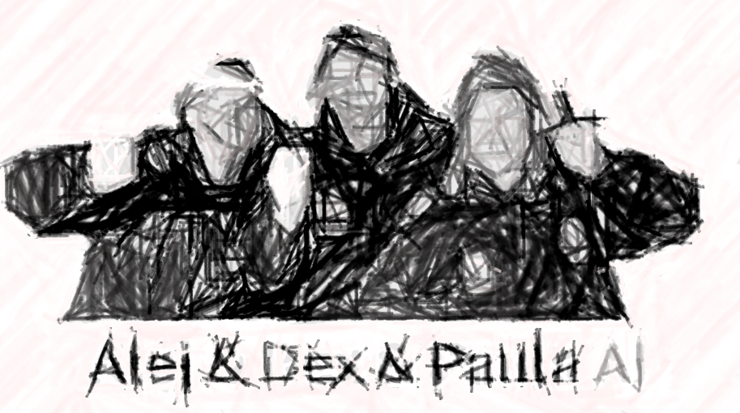
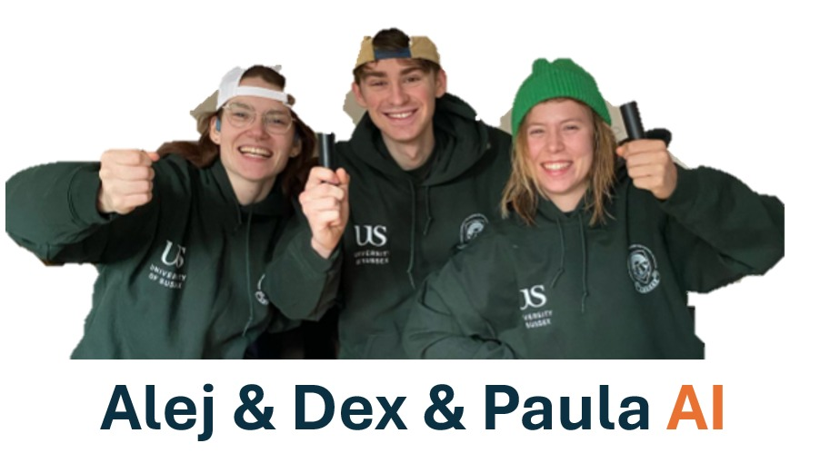





Recap
Dexter R. Shepherd & Paula Seidler
d.r.shepherd@sussex.ac.uk
University of Sussex

Slide 2
Recap
Employed methods like PCA and dimensionality reduction
Learned about classifiers and regression models
Worked with datasets and open dataset

Slide 3



Dimensionality reduction
Method | Type | Output | Best for
PCA | Linear | Axes of variance | Denoising, compression
t-SNE | Nonlinear | 3d/2d embeddings | Visualisation of local clusters
UMAP | Nonlinear | 3d/2d embeddings | Visualisation + structural relationships
VAE | Deep learning, nonlinear | Low-dim latent space + decoder | Modelling, simulation, generative tasks

Slide 4
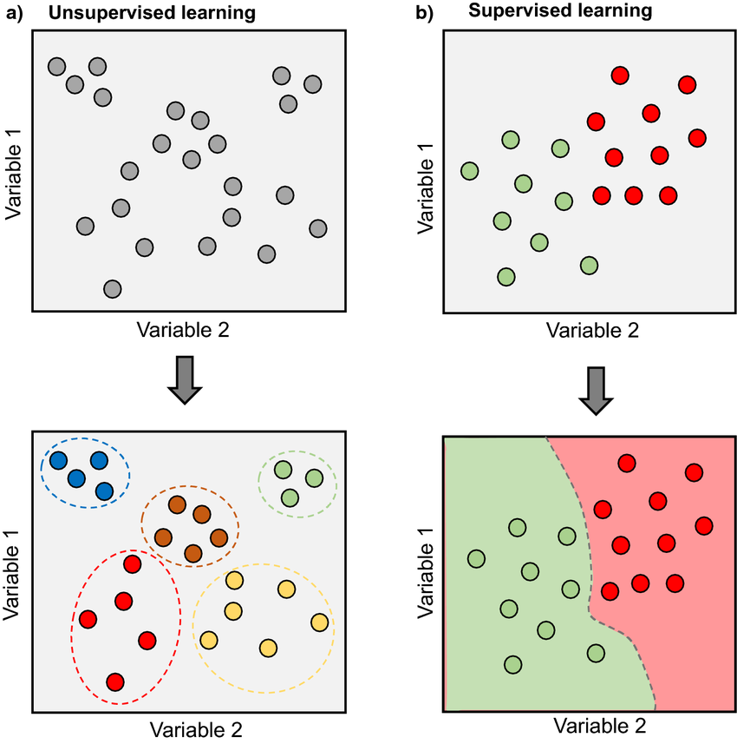
Classification models
Learn to categorize data into distinct groups or classes
supervised classification:
Support vector machines: linearly separable data
Random forest: non-linearly separable data
unsupervised clustering:
K-means: clustering of similar instances
Artificial neural networks: wide range of problems

Slide 5
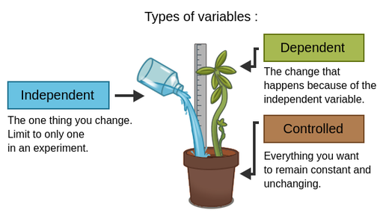
Regression
Learn statistical trends in the data, predict one variable based on others
Linear regression
Multi-linear regression
Logistic regression/GLMs

Slide 6
Contents
Fail cases of machine learning
How we can be robust
Data augmentation

Slide 7
What does accuracy tell us?
How much of this data we got correct
But does our dataset represent everything?

Slide 8
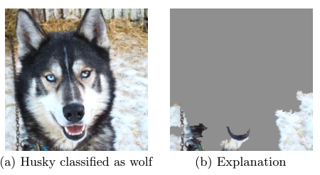
Example
A model trained to distinguish between dogs and wolfs
Jiawei, "One pixel attack for fooling deep neural networks." IEEE TEC 2019
Ribeiro, Singh, and Guestrin. "" Why should i trust you?" Explaining the predictions of any classifier." ACM SIGKDD 2016.

Slide 9
Investigating robustness
Test the data on unseen data!
Still this might not be enough, lets say it is based on weather data, if you only gathered in one season it will almost certainly get incorrect predictions – how can we solve?
Data augmentation – what exactly has the model learned?

Slide 10
Data augmentation
Changing your original data to be nosier, or less clear
Can improve model accuracy when working with small datasets

Slide 11
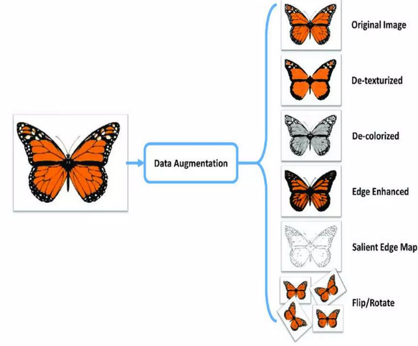
Data Augmentation
When we have a small dataset of images, we can oversample them by performing data augmentation.

Slide 12
What augmentation should I use?
This depends on your data and task, as some augmentation may negatively impact your model
What types of data modifications preserve the original meaning for your task?

Slide 13
The key thing to remember
Your data still must represent the trends!

Slide 14
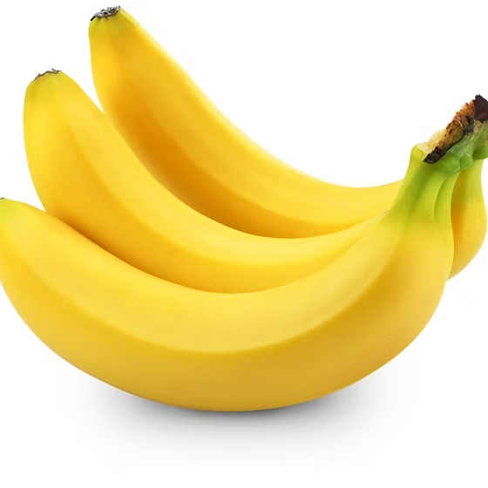
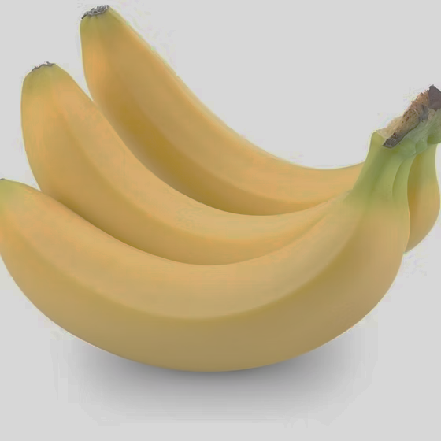
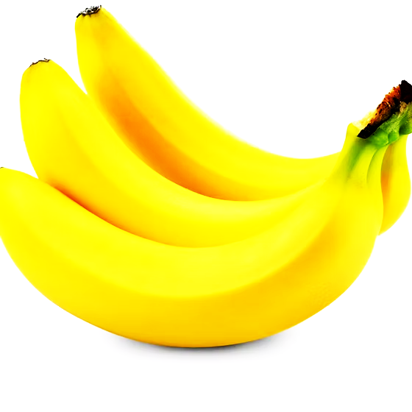
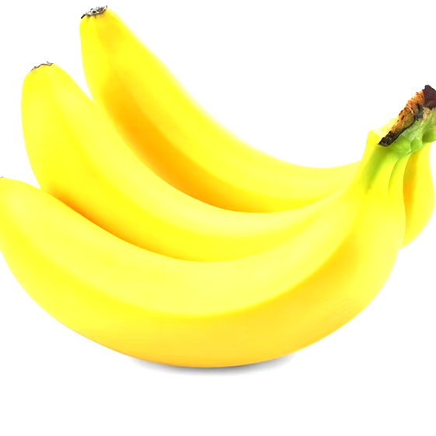
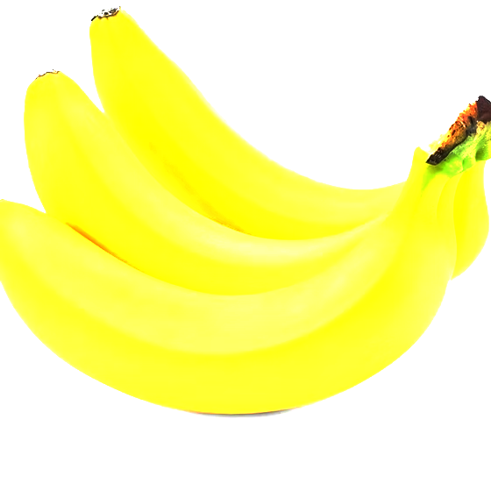
Banana detection
Detexturized
Edge enhance
Flip and rotate

Slide 15
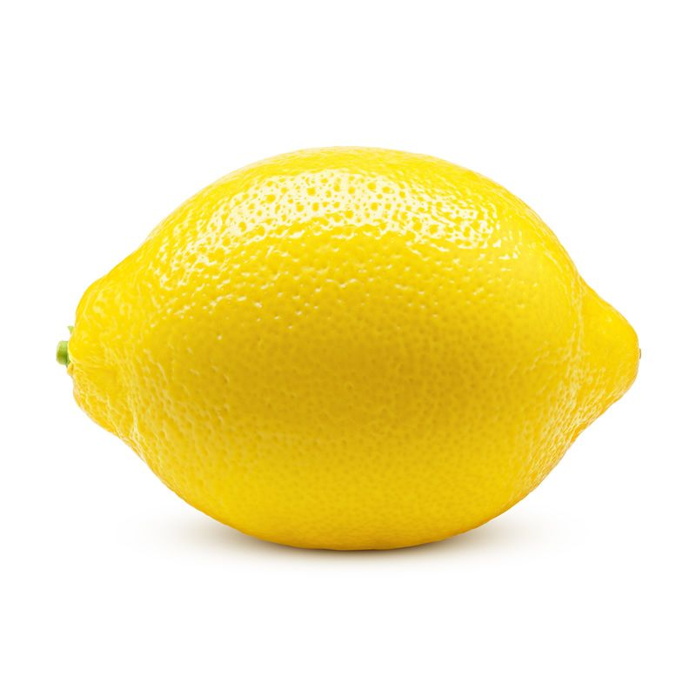
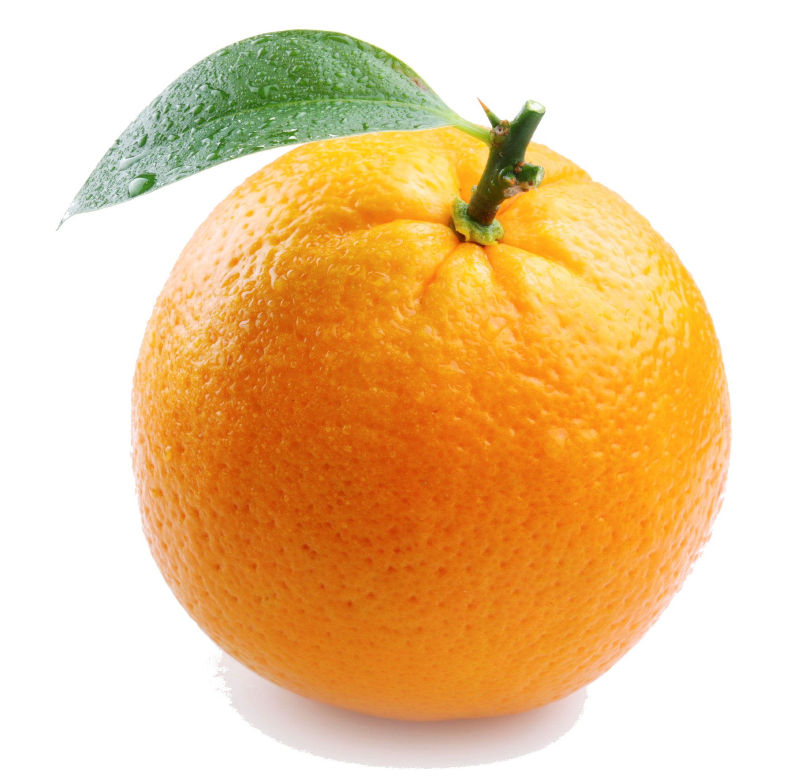
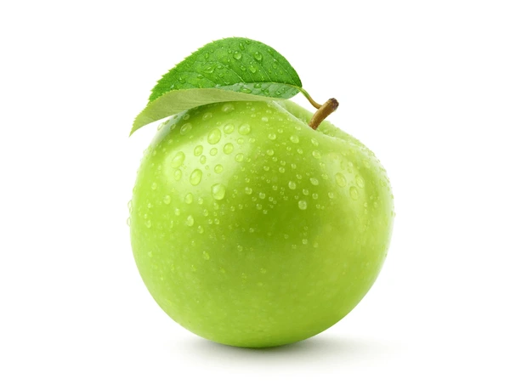
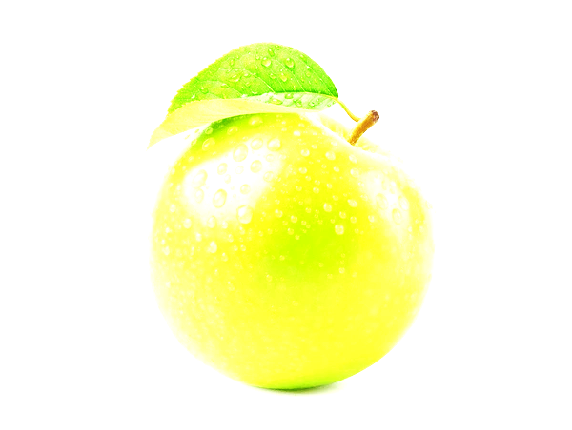
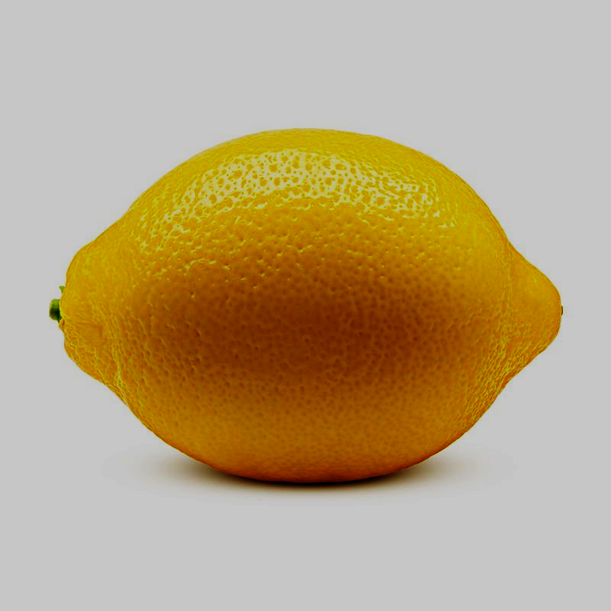
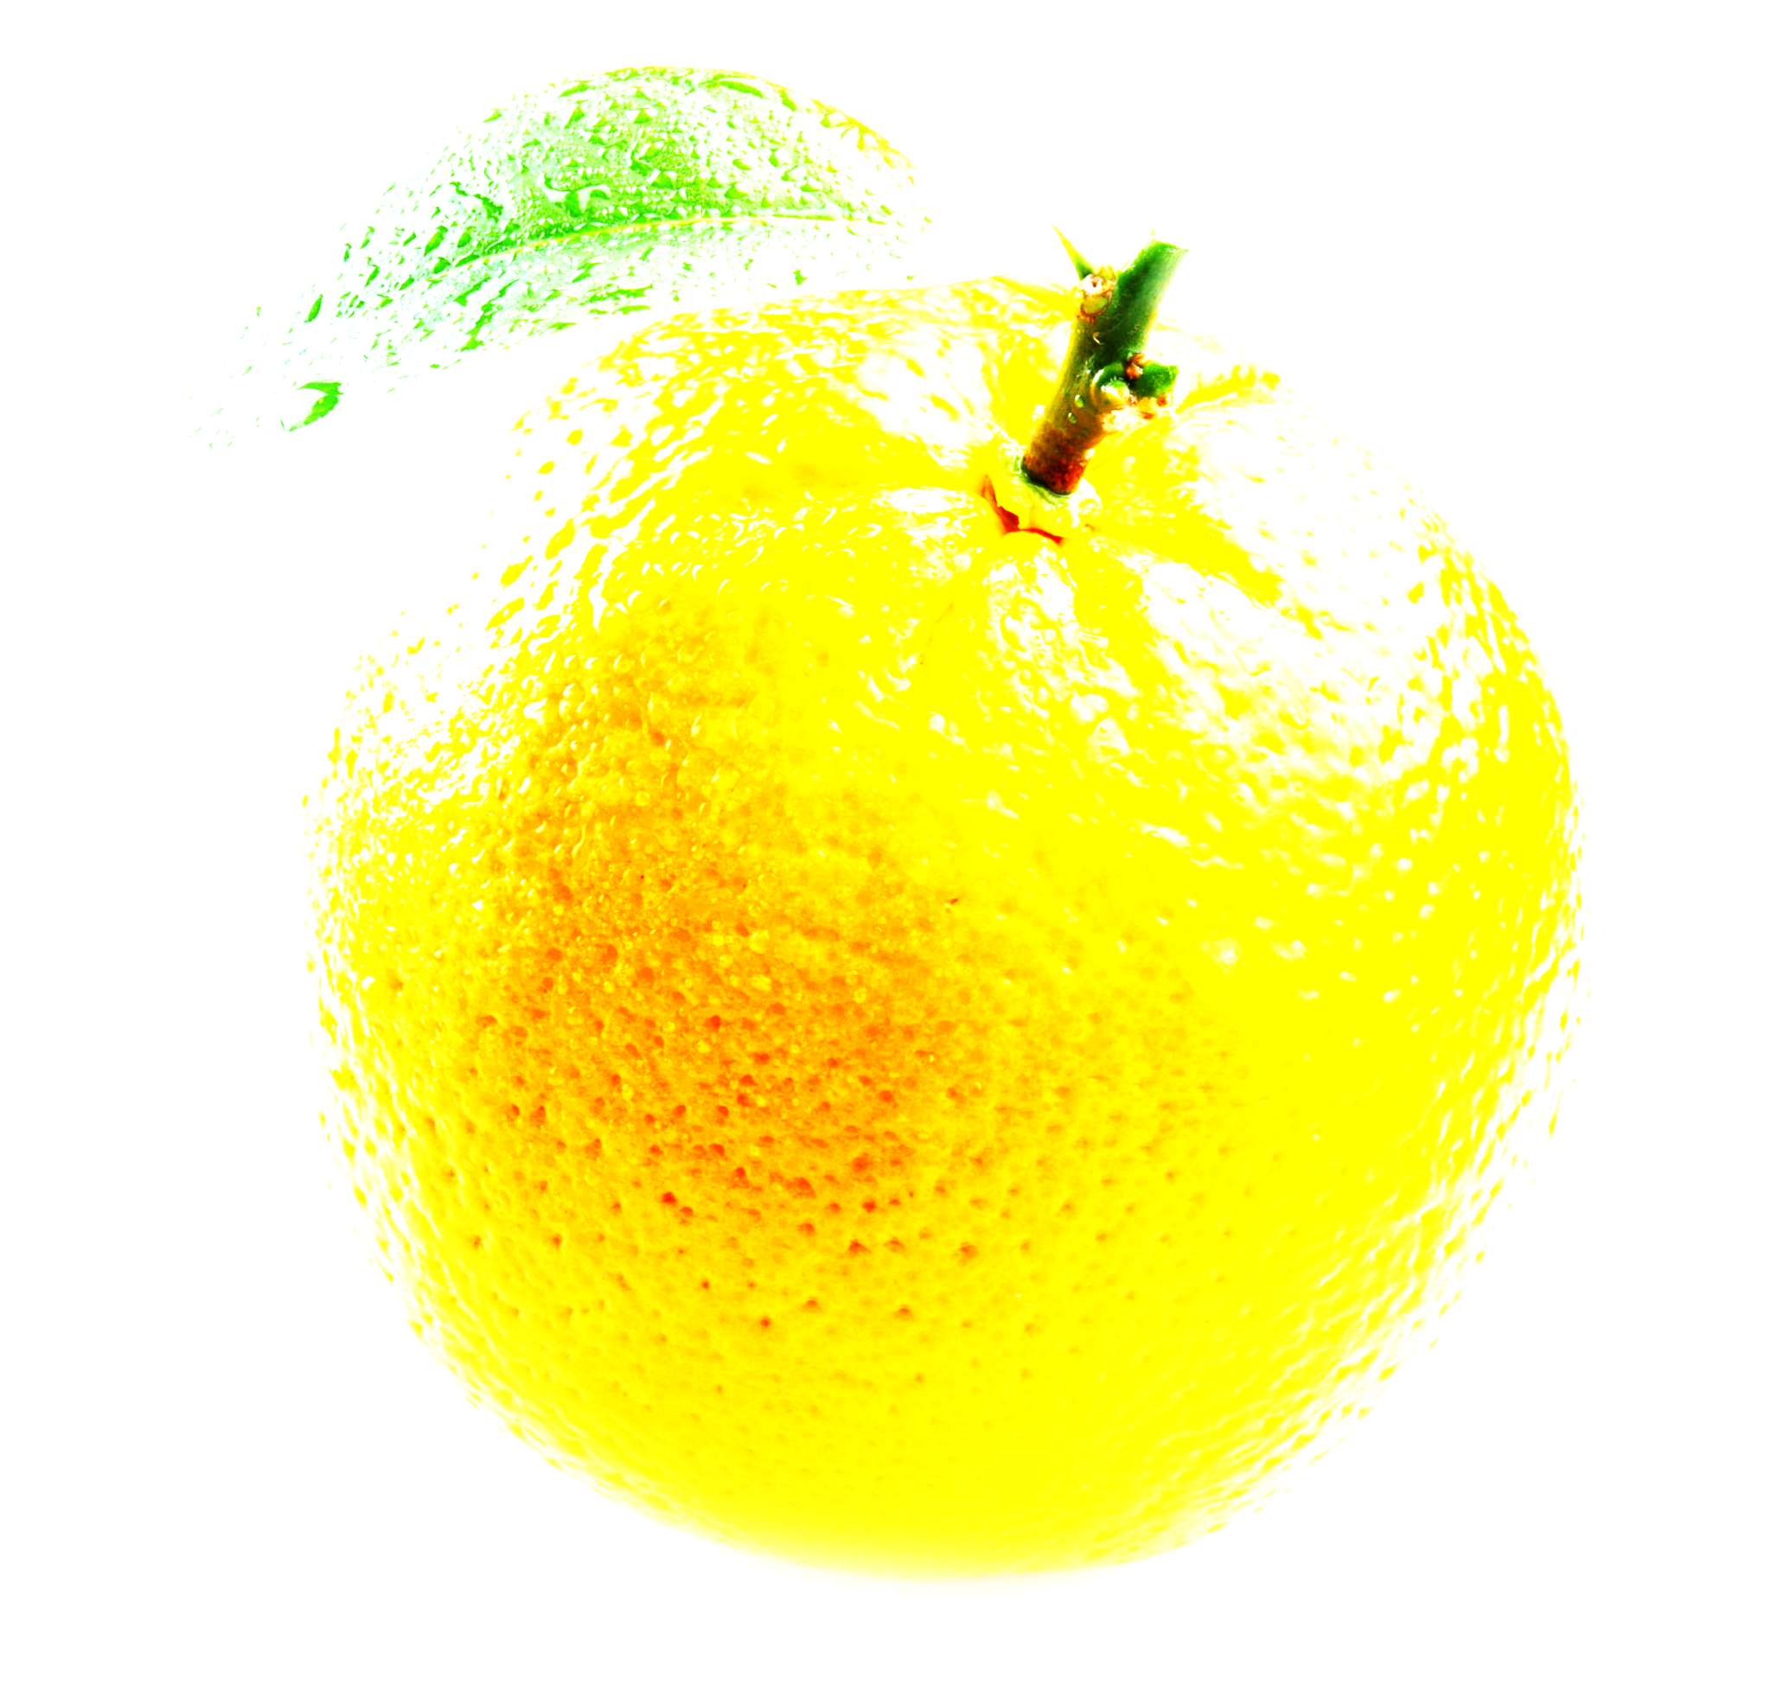
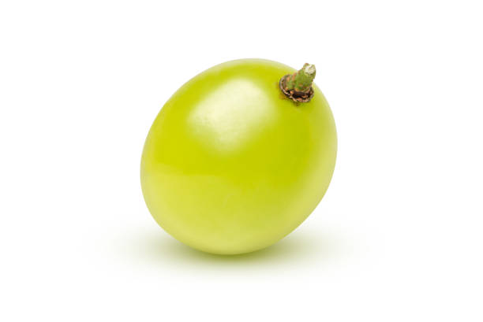
A larger classifier of fruit
Maybe the lighting does matter…

Slide 16
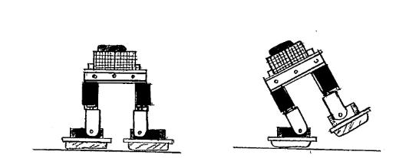
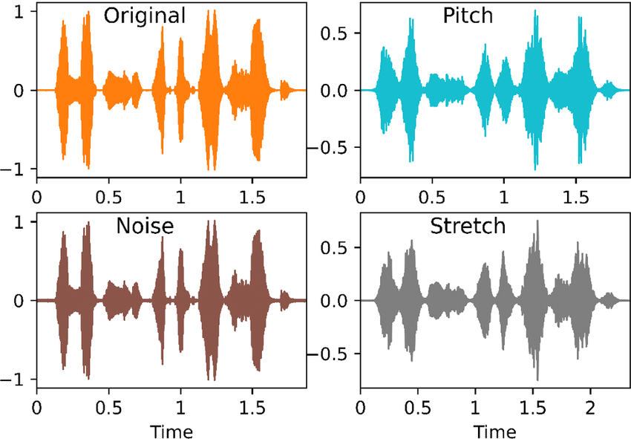
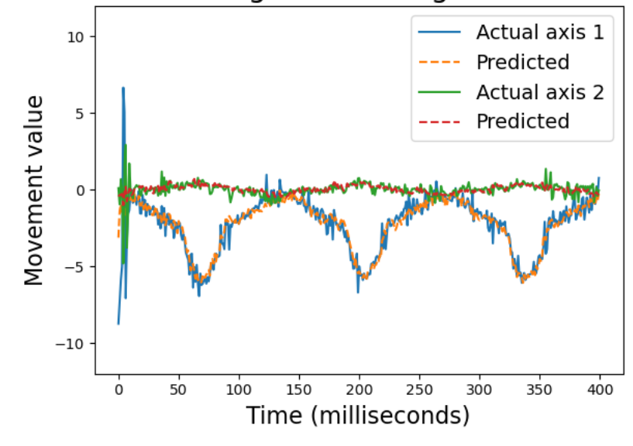
Signals
Augmentation is not limited to images…
Make sure to evaluate what data is relevant

Slide 17
Signals
Audio signals “hello world”
Stretch it: makes it slower spoken “heeelllooooo wwwoorrllddd”
Change the pitch augments it to different voices
This could be helpful for voice recognition

Slide 18
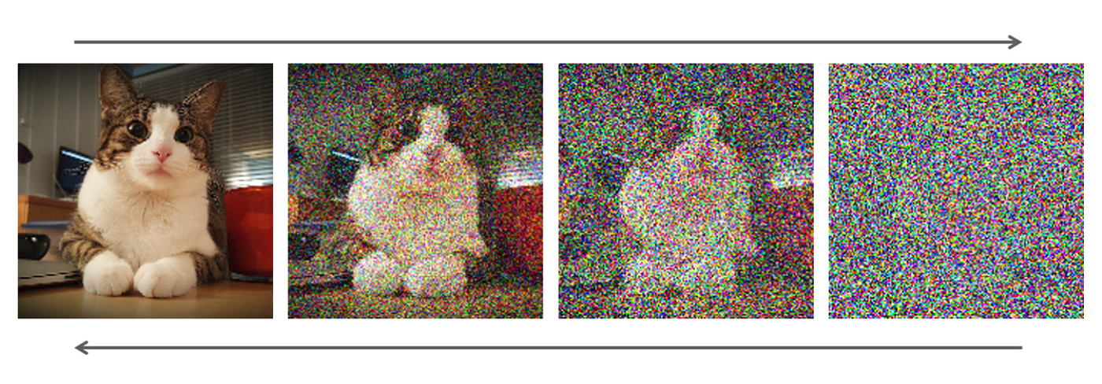
Adding noise
Can you rely on good image quality all the time?
Adding noise helps a model understand beyond specific colours

Slide 19
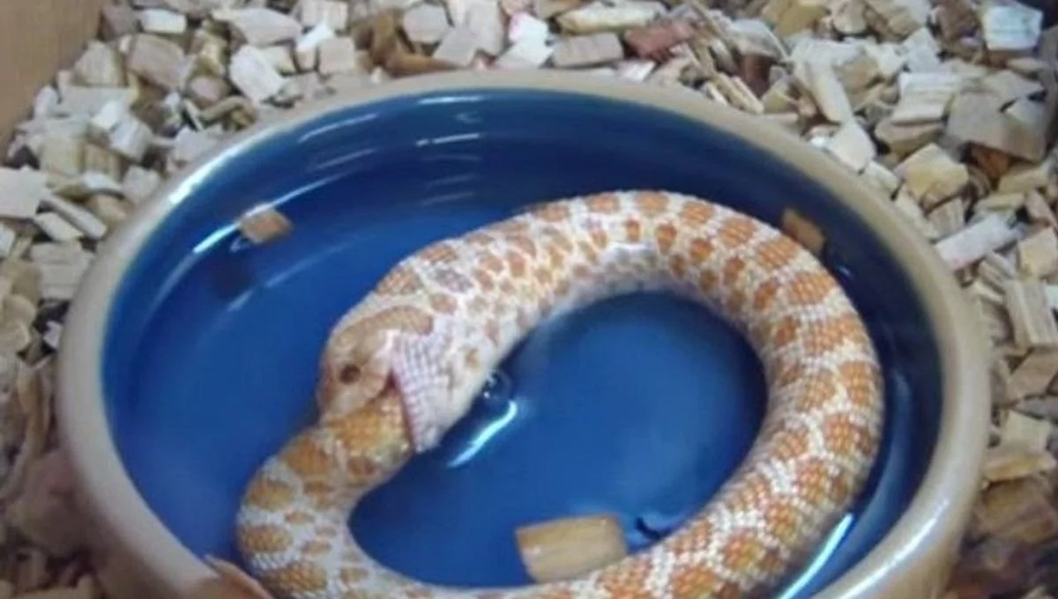
AI generated datasets
There is an approach of using AI to generate data.
Tasks where a lot of data exists such as image generation, this can be an inexpensive way of generating data
Generative AI can alter your existing images so there is a mix of truth and changes

Slide 20
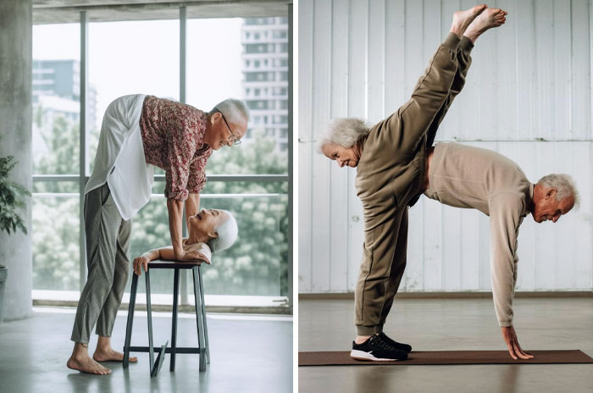
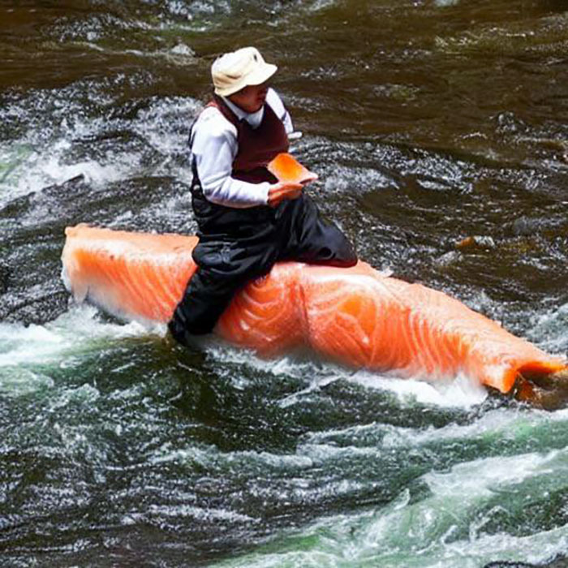
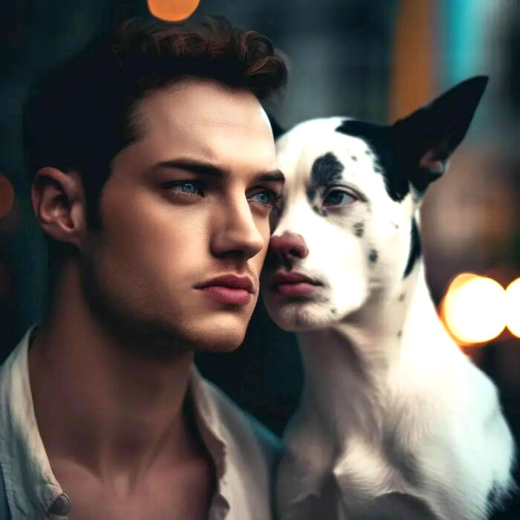
Problems
Bias
Data not being real enough

Slide 21
But they have some uses
Maybe not best for a full dataset… but can be used for transfer learning

Slide 22
Today
Catch up on worksheets
Go through worksheets with a new dataset from kaggle
Start implementing data augmentation on some of the models you have already developed
Eg. Add noise (investigate how much noise helps, and what too much noise looks like), feel free to play around with AI generated data from ChatGPT and see if this actually helps

